Slide 1

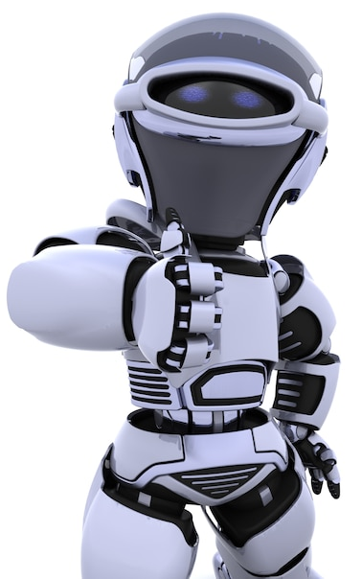
Artificial Intelligence – 30 Days Challenge - தமிழ்
Intro to AI | Creating Our Own Chatbot
DAY 1 / 30

Slide 2

Prerequisites for this Course
Be Ready with sufficient data
Laptop with Good Internet
No basic knowledge is required.
Note & Pen

Slide 3
Knowing + Not Doing = Not Knowing

Slide 4
“Learn to be a Lifelong Learner”

Slide 5
Ready For Session
Artificial Intelligence

Slide 6
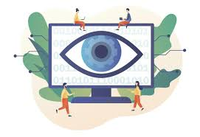
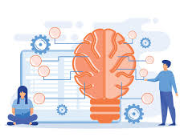
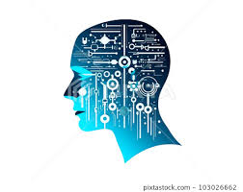
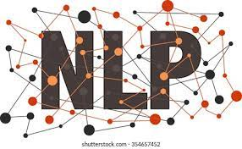
In this 30 Days
Computer Vision
Deep Learning
Natural Language
processing
Machine Learning

Slide 7
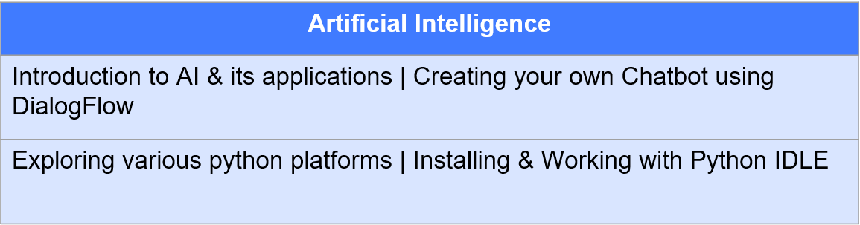
Introduction to Artificial Intelligence

Slide 8
Computer Vision
Computer Vision
Introduction to Computer Vision | Overview on CV libraries & installation
Moving Object Detection using OpenCV
Advanced Face Detection and Tracking
Object Tracking based on Color with OpenCV
Face Recognition with OpenCV
Recognizing Emotions from Faces

Slide 9
Deep Learning
Deep Learning
Introduction to DL| how to install DL libraries
Deep Learning Algorithms
Neural Network Design | Diabetes prediction
Real-time Object recognition using Pre-trained Model
Image Classification using Convolutional Neural Networks
Hand Gesture Recognition with Deep Learning
Detecting Plant Leaf Diseases using Deep Learning
Character Recognition with CNN and PyQt5 GUI
Label reading using Optical Character Recognition OCR
Attendance System Face Recognition using DL & ML
Vehicle Detection and Tracking
License Plate Recognition System
Drowsiness Detection for Driver Safety
Road Sign recognition for autonomous vehicle

Slide 10
Machine Learning
Machine Learning
Introduction to Machine Learning | ML Algorithms
Heart Disease Prediction using Machine Learning
Titanic Survival prediction using NAIVE BAYES
AI Snake Game - Reinforcement Learning

Slide 11
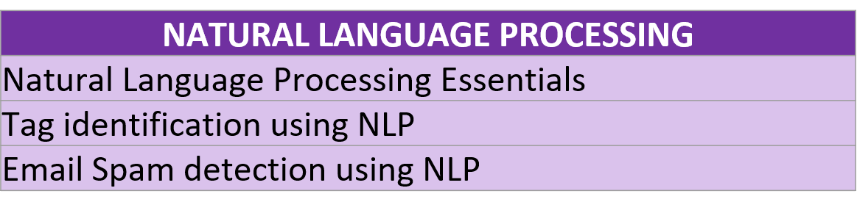

Natural Language Processing
Evaluation Metrics for classification

Slide 12
Ready For Hands-On
Chatbot Creation

Slide 13




THANK YOU☺
Join our What’s app Community group
novitechresearchanddevelopment

